Slide 1
PHARMACEUTICAL SALES ANALYSIS
In our project, we've learned how to utilize SQL for effective data management in databases.
By mastering around 20 different types of SQL queries, we were able to extract specific information, perform calculations, and neatly organize data.
SQL has proven to be an invaluable tool, handling tasks from finding a name in a list to analyzing large datasets.
This project emphasized the importance of SQL in today's data-driven world, where efficiently managing large datasets is crucial for businesses.
Now, we're applying our SQL skills to analyze pharmaceutical sales data, allowing us to uncover valuable insights and make informed decisions for the pharmaceutical industry.

Slide 2
Project Summary
Data Overview
Retrieved all columns for all records in the dataset.
Counted the number of unique countries represented.
Listed all distinct months present.
Filtering and Selection
Selected names of customers on the 'Retail' channel.
Retrieved sales made in 'Rendsburg' in 2018.
Found customer with highest sales.
Retrieved sales reps managed by 'James Goodwill'.
Aggregation and Calculation
Calculated total quantity sold for 'Antibiotics'.
Found total sales for each year.
Calculated total sales for each product class, by month and year.
Retrieved top 5 cities with highest sales.
Found top 3 sales reps with highest sales in 2019.
Calculated monthly total sales for each sub-channel and average monthly sales.
Sorting and Ranking
Found top 5 sales reps with highest sales for each year.
Listed months with lowest sales for each year.
Advanced Analysis
Calculated year-over-year growth in sales for each country.
Joining Tables
Joined 'Employees' table with 'Sales' table to get Sales Rep names and corresponding sales.
Subqueries and CTEs
Calculated total sales for each sub-channel in each country and found country with highest total sales for each sub-channel.

Slide 3
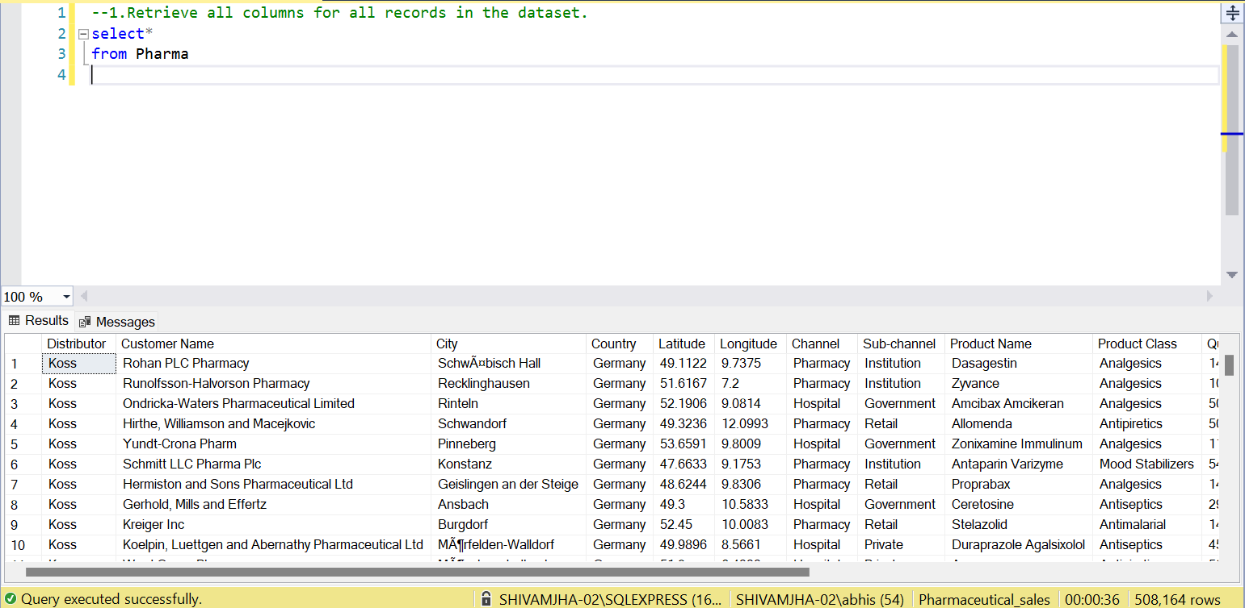

Slide 4
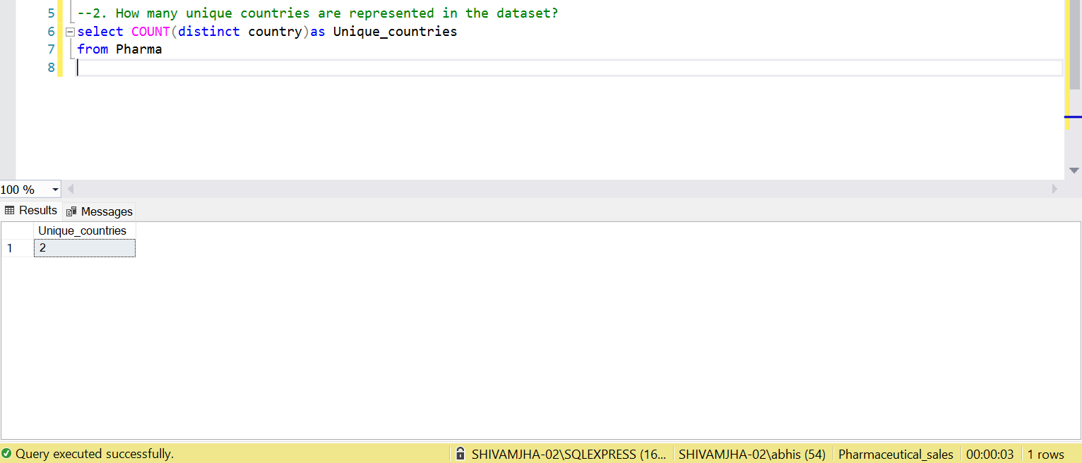

Slide 5
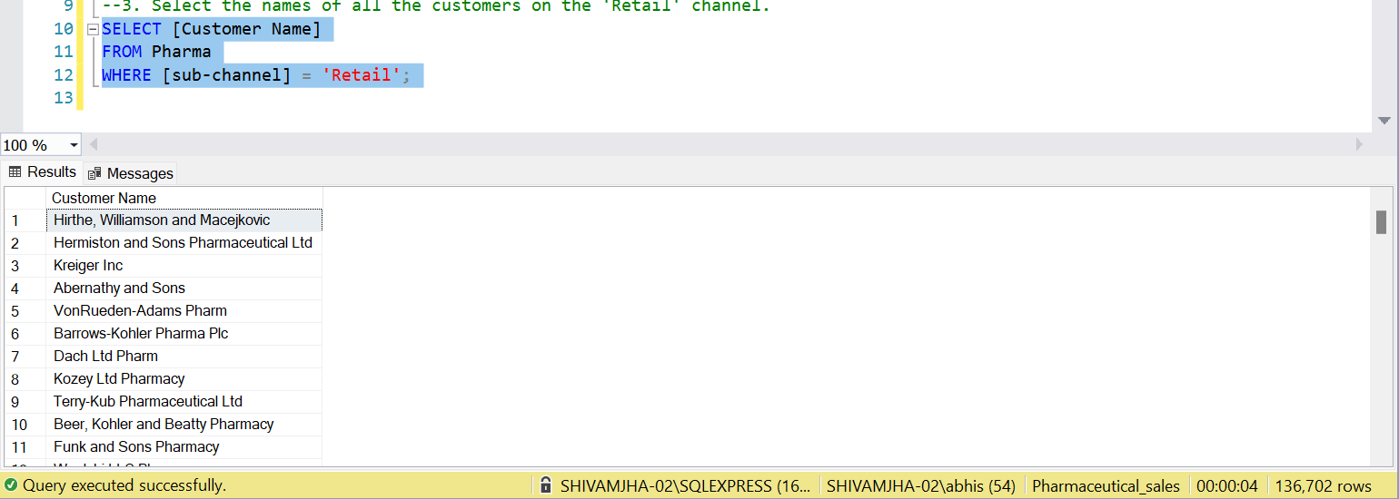

Slide 6
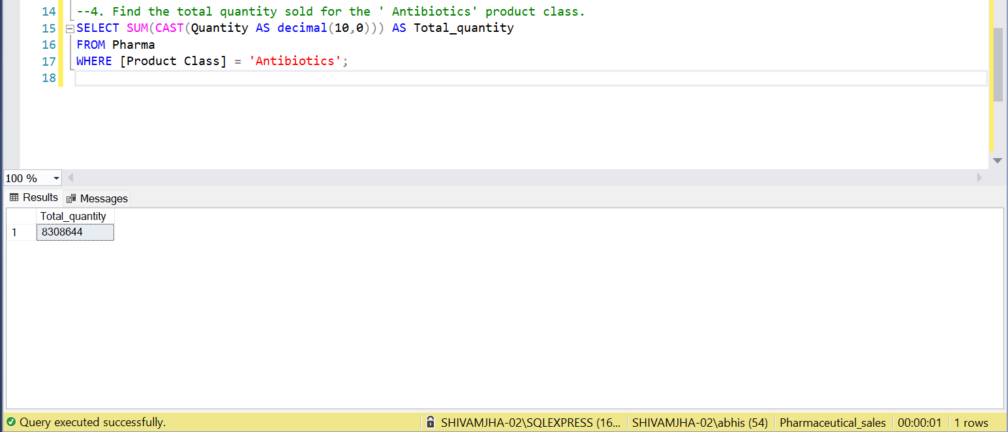

Slide 7
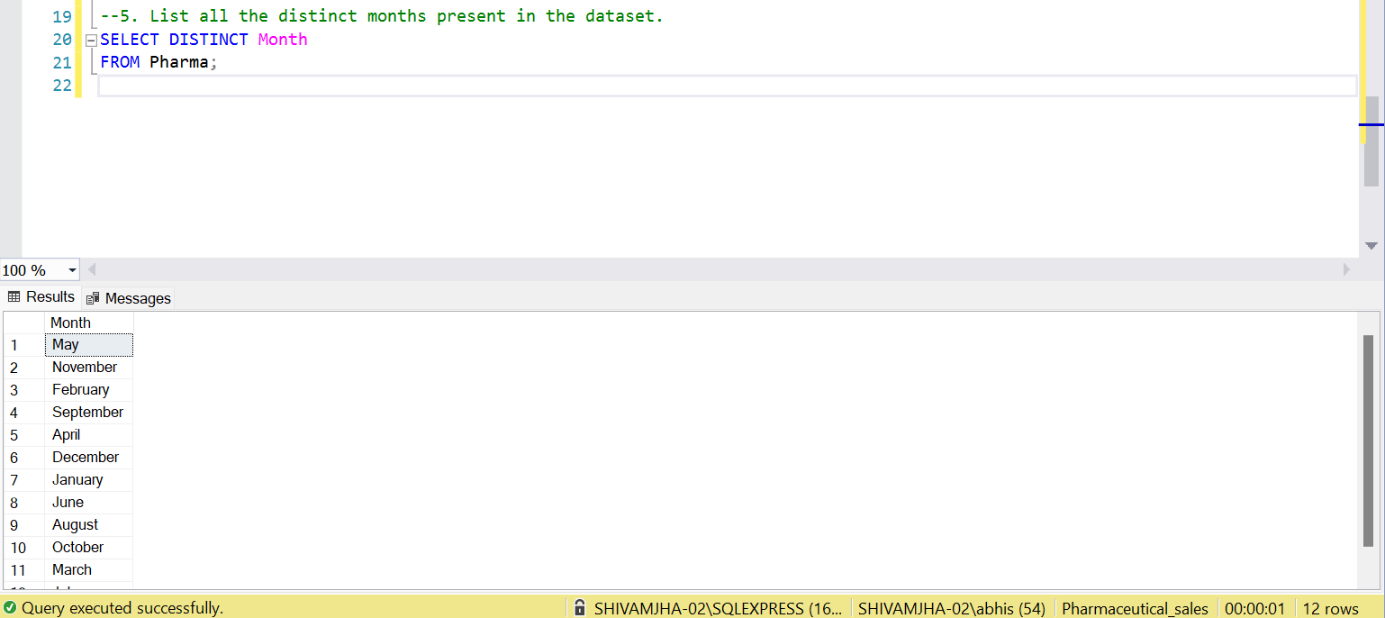

Slide 8
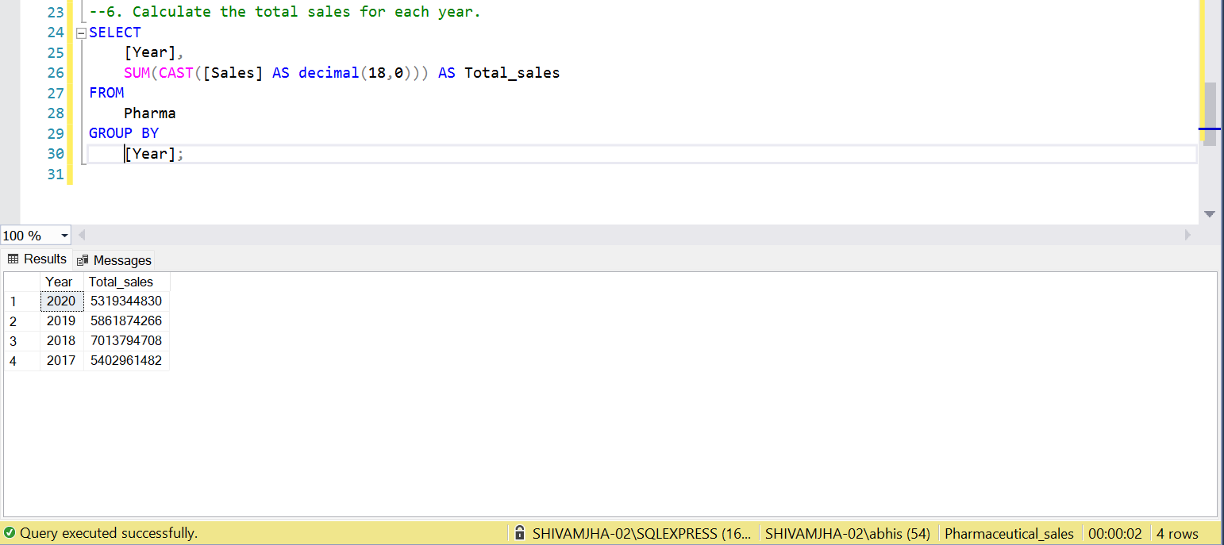

Slide 9
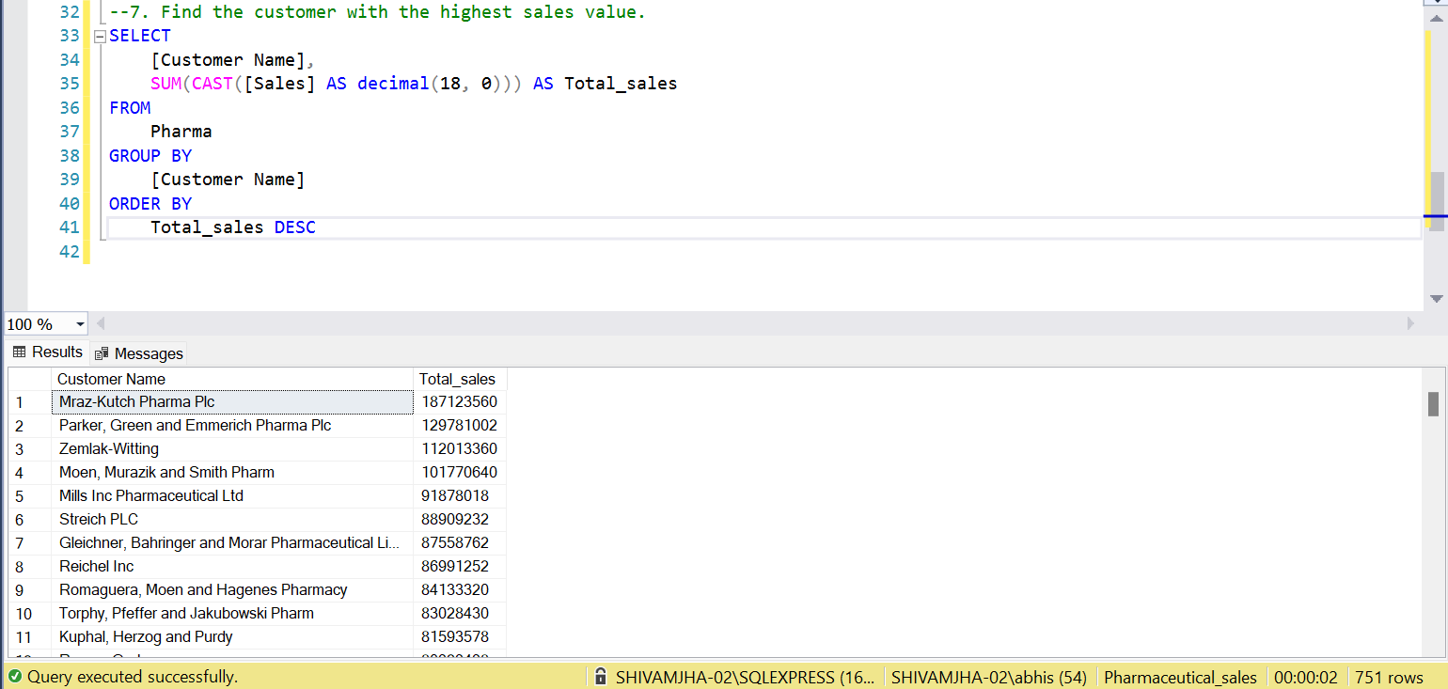

Slide 10
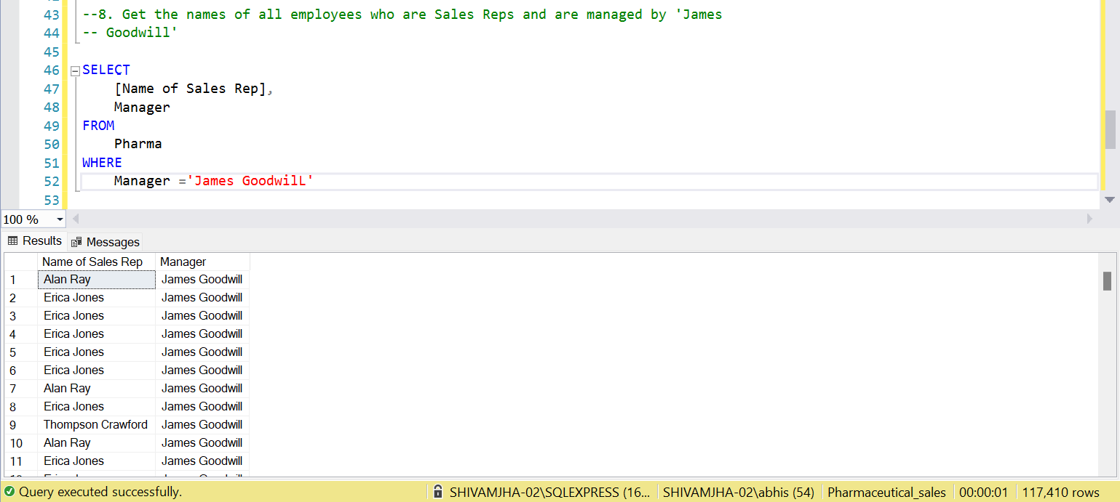

Slide 11
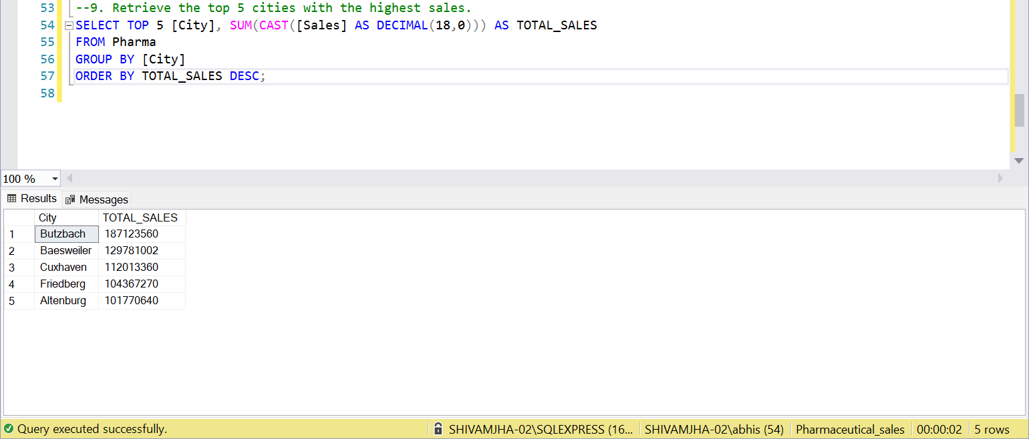

Slide 12
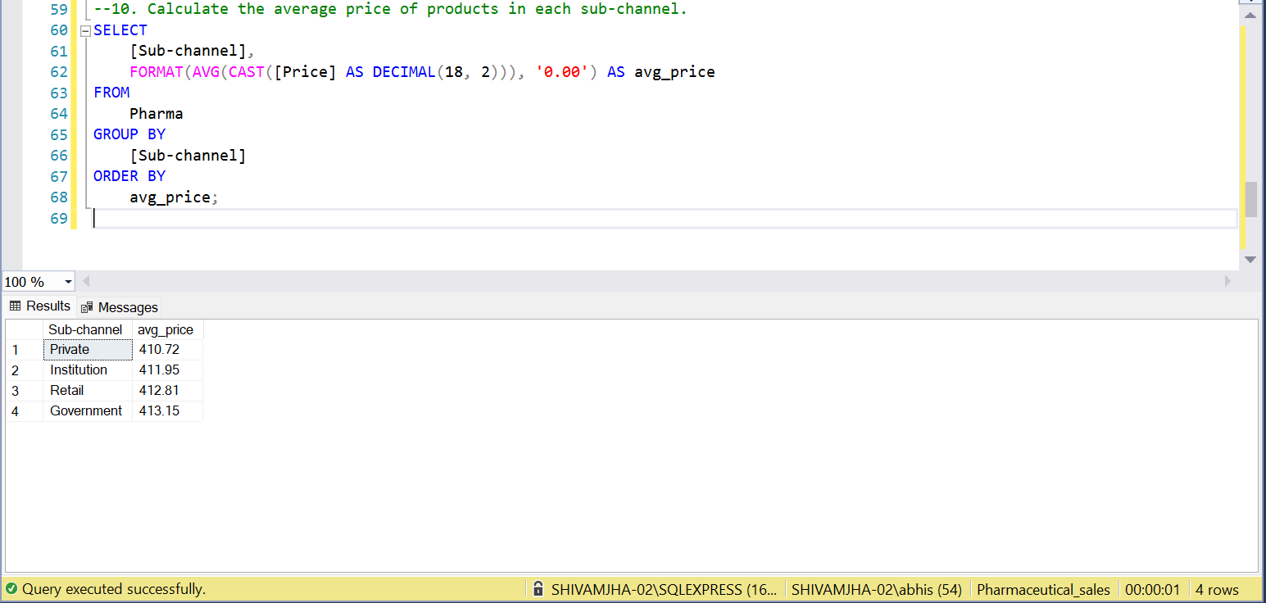

Slide 13
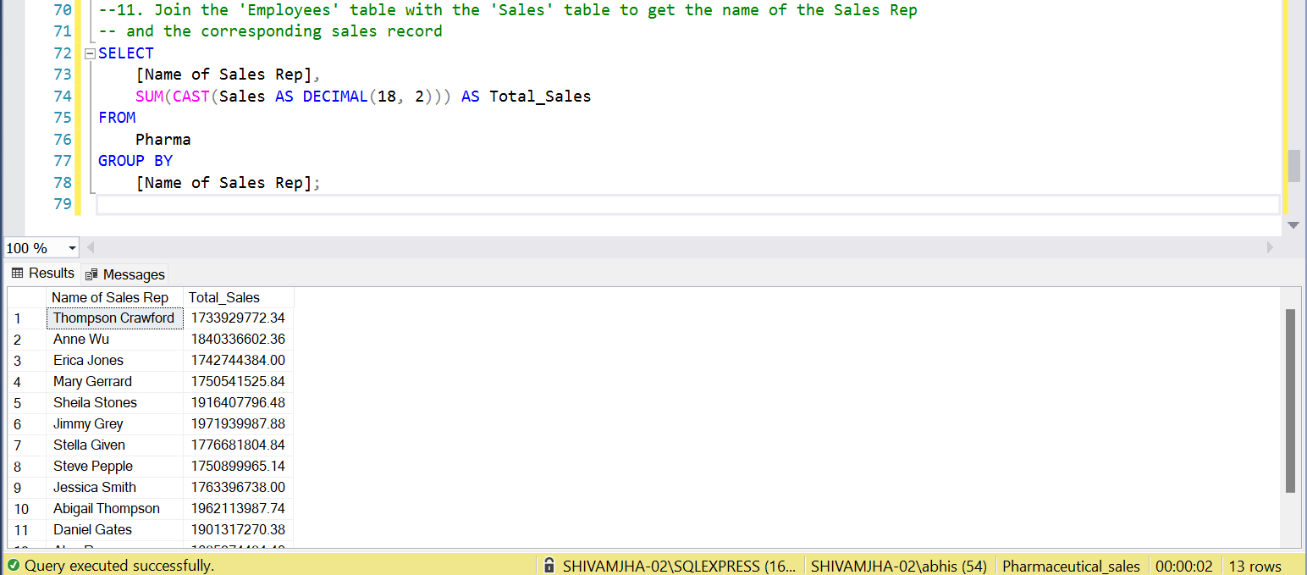

Slide 14
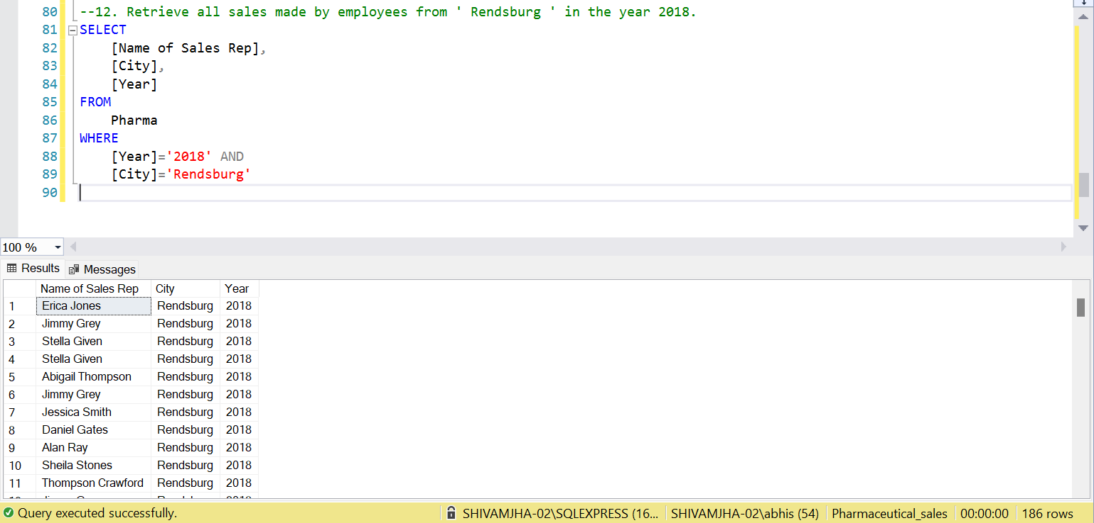

Slide 15
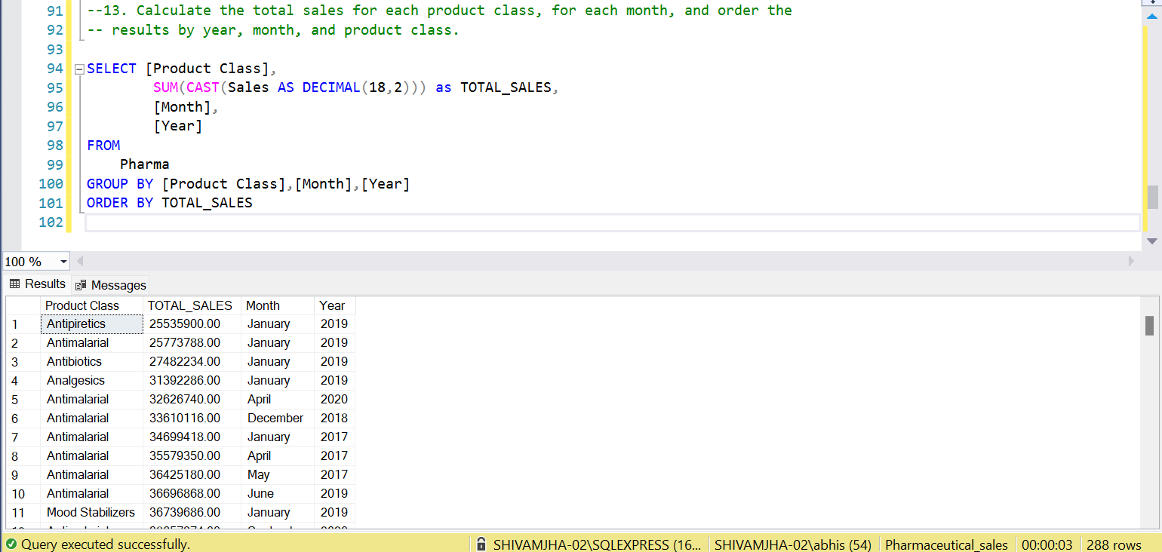

Slide 16
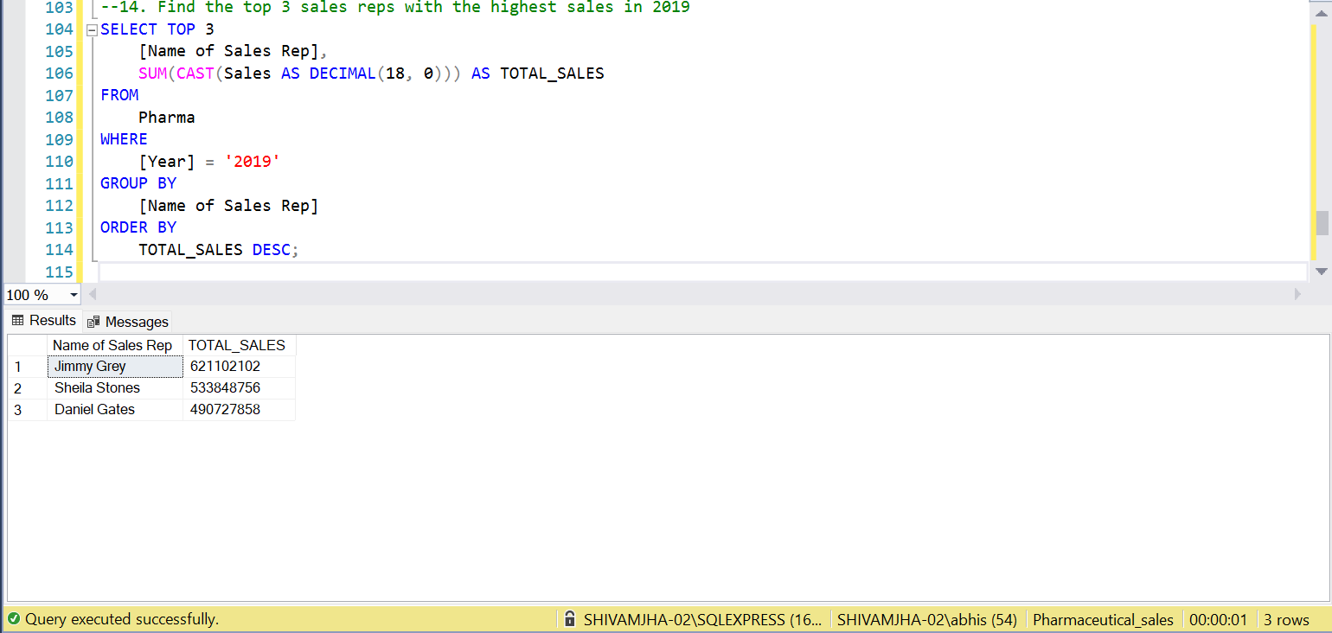

Slide 17
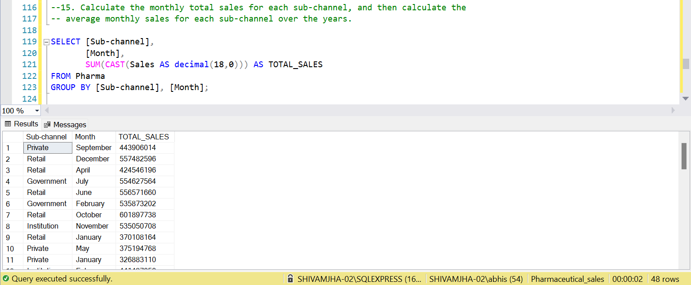

Slide 18
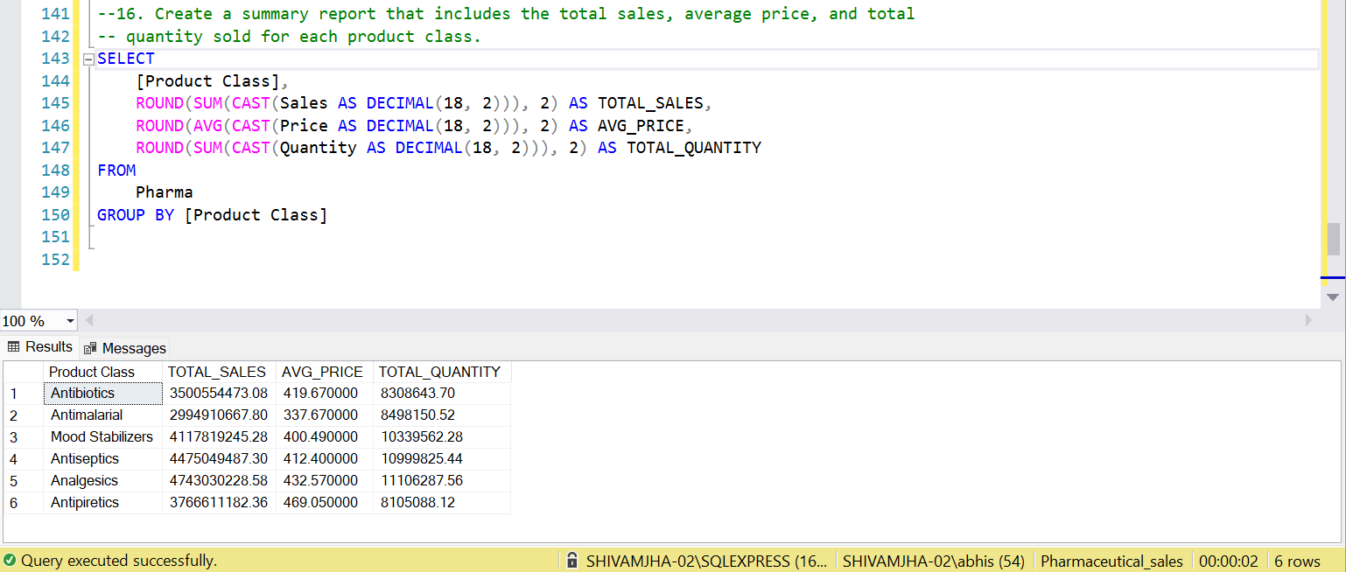
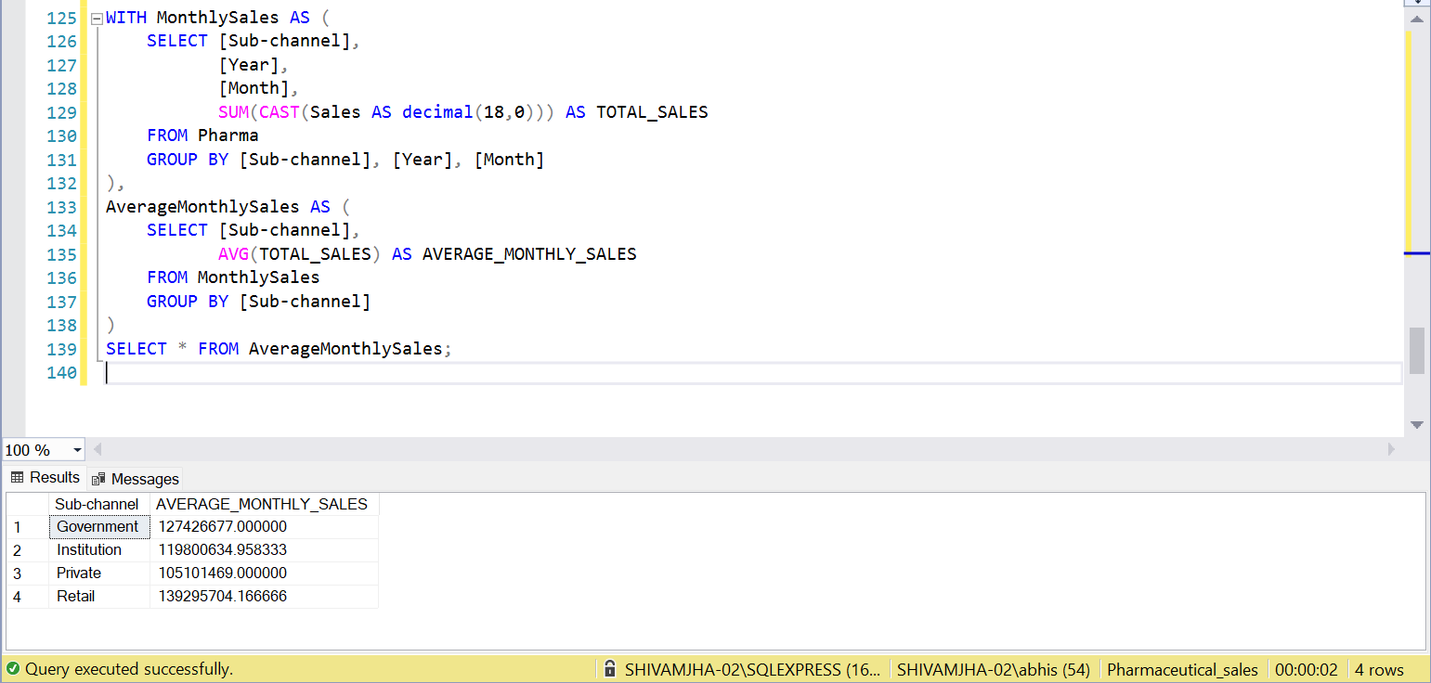

Slide 19
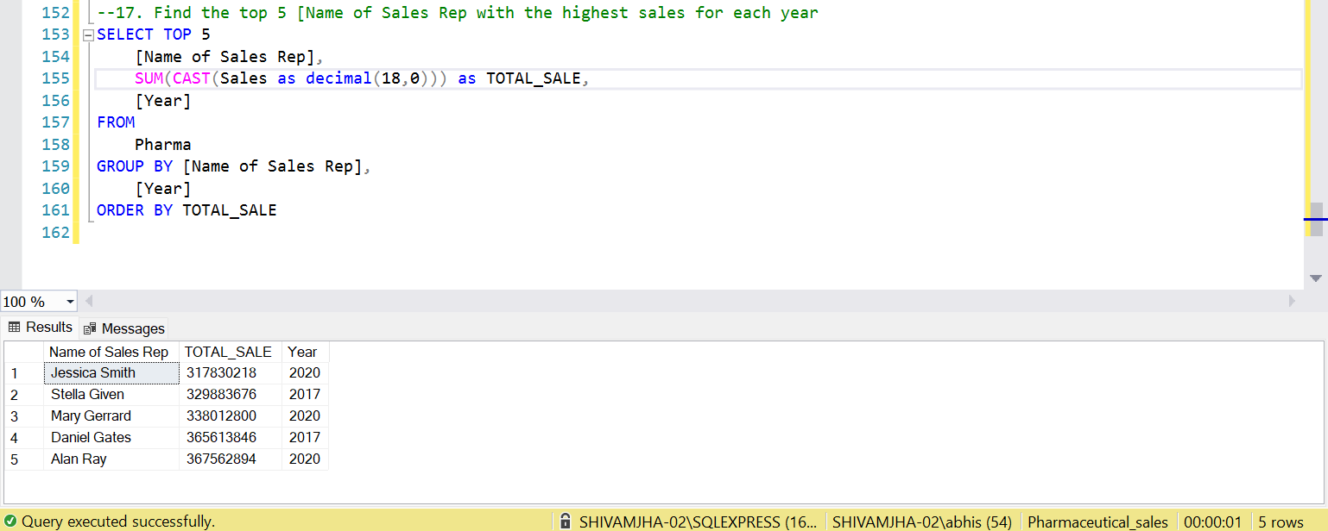

Slide 20
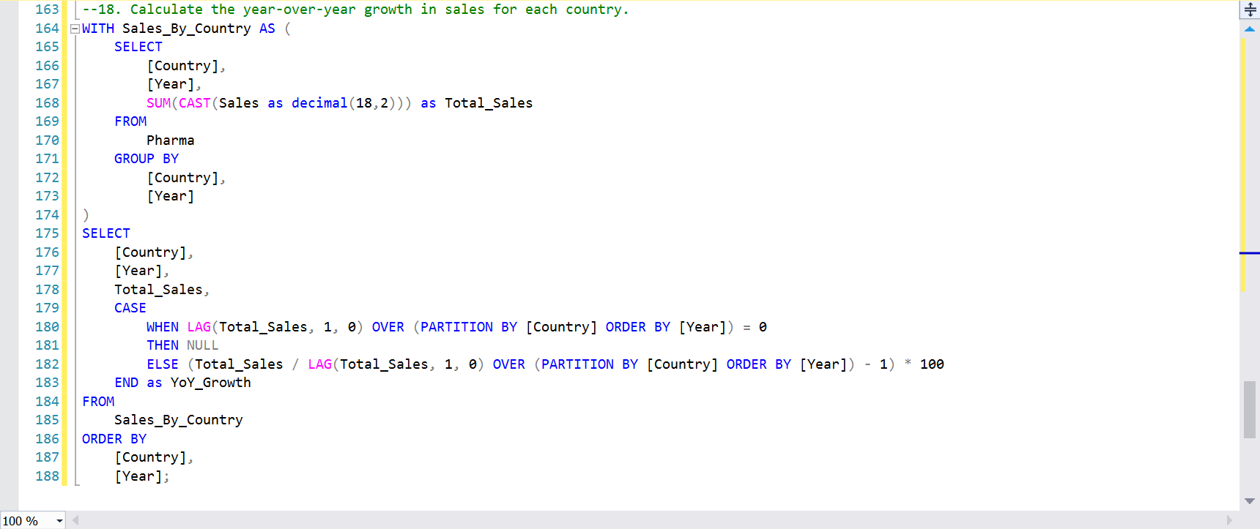
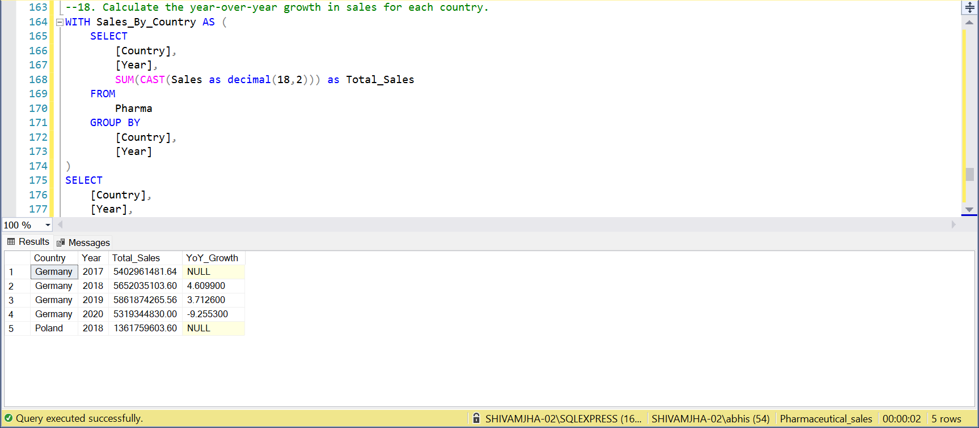

Slide 21
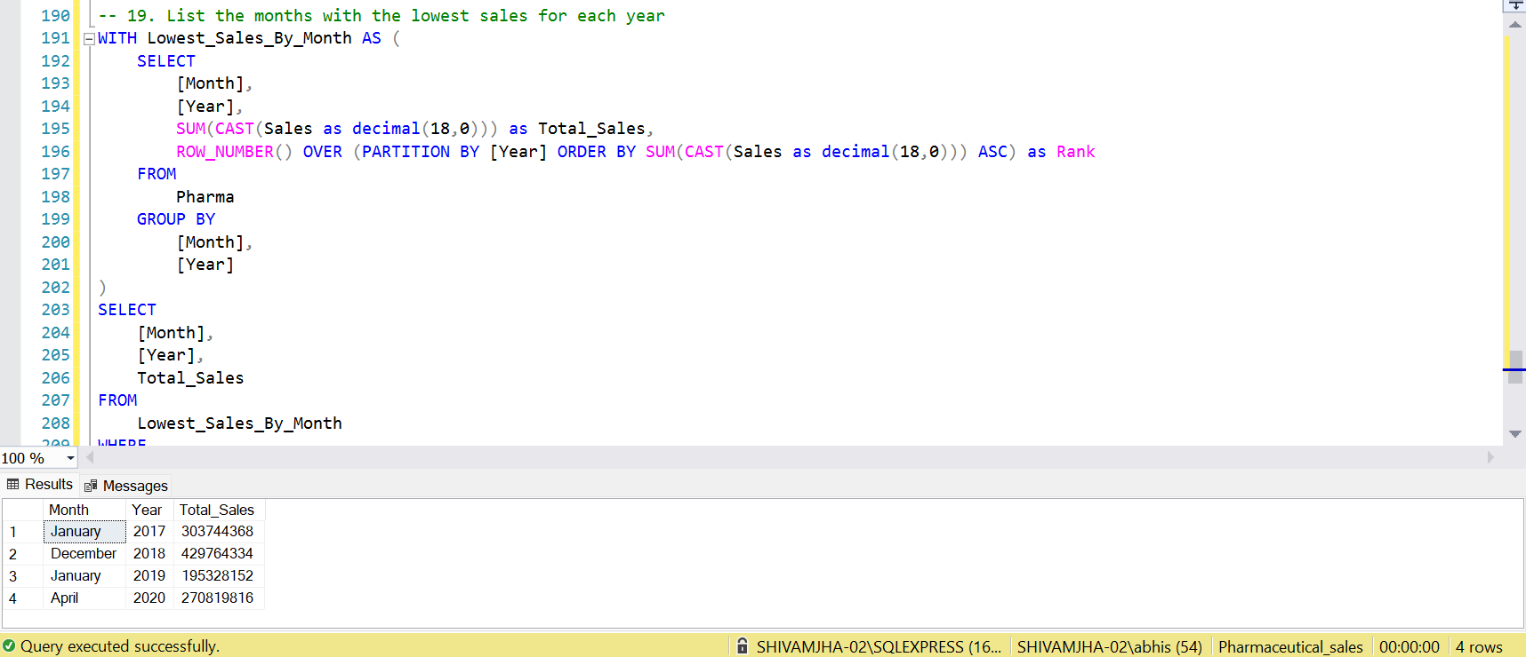

Slide 22
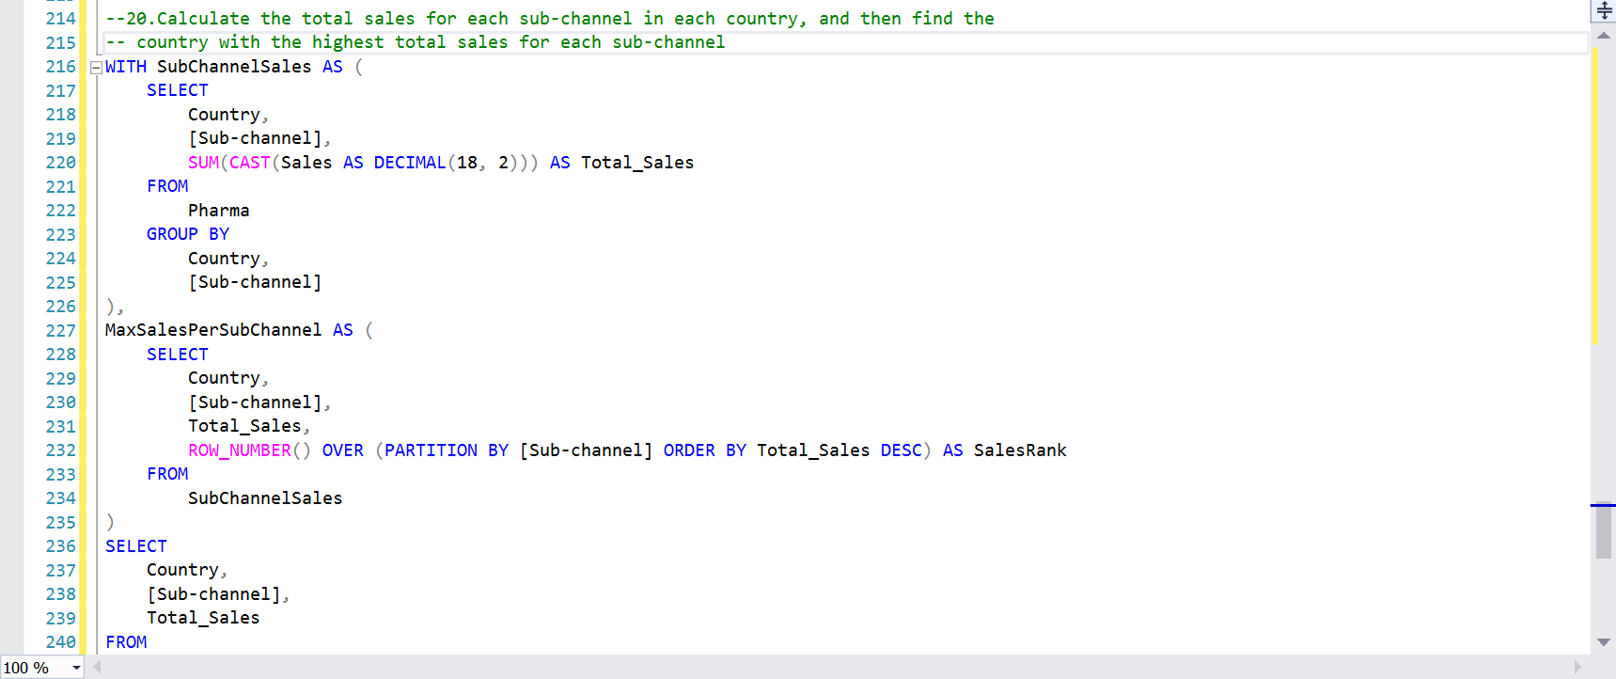
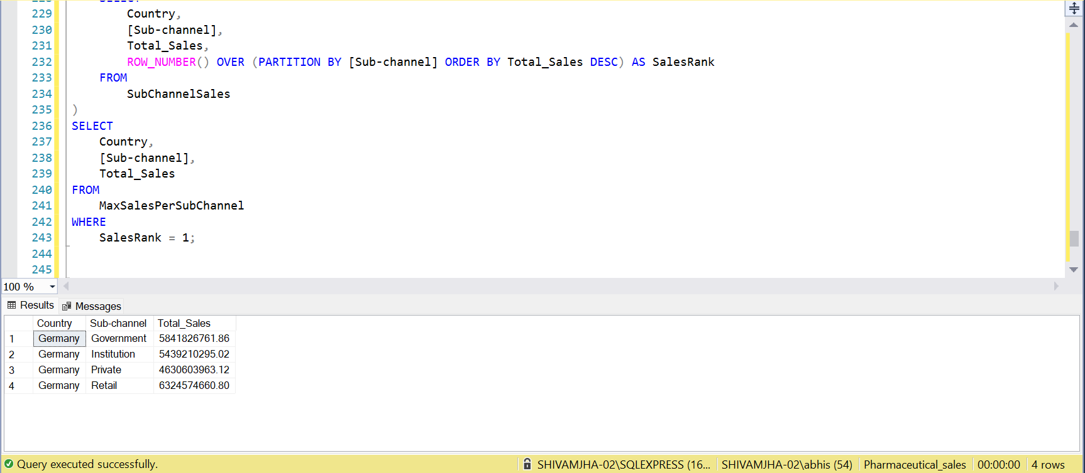

Slide 23
Thank you

